Slide 1
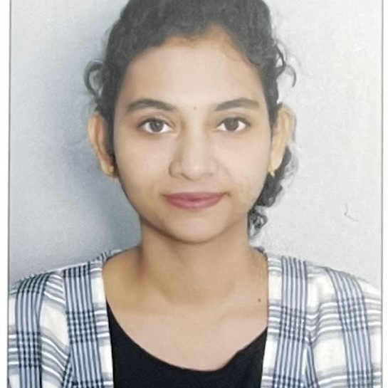

ASHITHA DAVU
Analyst/Software Engineer
Bachelor of Engineering
Electronics & Communication : 2018 - 2022
Skills
BANGALORE
Java 8 /J2EE | Java Basics, OOPS, Generics, Collections, Arrays, Loops, Lambda Exp, Stream API Junit, Mockito
Spring core | IOC & Dependency Injection, Autowire
Spring REST | REST controllers, Implementation of GET, POST, PUT & DELETE, Bean Validation & Exception Handling, Testing Services, Controller & Repository layer
Spring Data JPA | Implement DAO layer using spring Data repositories, Transaction Management
Spring Boot Microservices | Spring Boot Starters, annotations, Sync/Async comms, Swagger API documents
Spring Cloud | Eureka, Netflix Hystrix, & Config Server
React | Components, Hooks, Event handling, Redux, Reducers
Database | MongoDB No Sql Basics,PostgresSQL
UI Tech | HTML 5 & CSS 3,JavaScript, ES6 , Reusable templates, Optimized UI Designed
Tools | Git, Postman, Maven, IDE
Devops | CI/CD, Jenkins configuration, Build Pipelines, notifications, quality gate understanding
Add On skills | Communications, Team management. Peer learning
ASHITHA.DAVU@CAPGEMINI.COM
+91 7396817275
A4
Full Stack Developer
Hands on experience in creating microservices with Springboot , Spring Security, Spring Cloud API Gateway, Eureka server and load balancing
Hands on experience in building web pages using HTML , CSS , Bootstrap , React
Hands on experience in implementing polyglot architecture with spring boot & backend
Development experience using Eclipse , VS code , pgAdmin for postgres , postman API connection and MongoDB
Flight Booking System
Completed end to end case study of Flight Booking System along with JWT authentication, Swagger documentation , testing using Junit and Mockito and React Js used for user interface.
Online Hotel Booking
Completed these backend applications using Monolithic Architecture and implemented all the CRUD operations using Spring Boot , Postgres , Postman
Check out my work on GitHub
https://github.com/ashithadavu/

